Slide 1
Multi Layer Neural Network
Prasenjit Manna
Trupthi D
Mamatha B K
Saurabh Singh

Slide 2
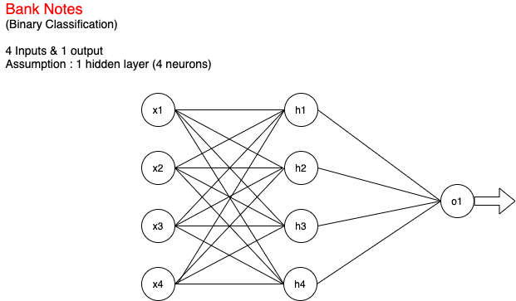
Multi Layer Neural Network
# DataSet
The Banknote Dataset involves predicting whether a given banknote is authentic given a number of measures taken from a photograph.
It is a binary (2-class) classification problem.
With 4 input variables and 1 output variable. The variable names are as follows:
Variance of Wavelet Transformed image
Skewness of Wavelet Transformed image
Kurtosis of Wavelet Transformed image
Entropy of image
1. Class (0 for authentic, 1 for inauthentic).
Ref: http://archive.ics.uci.edu/ml/datasets/banknote+authentication

Slide 3
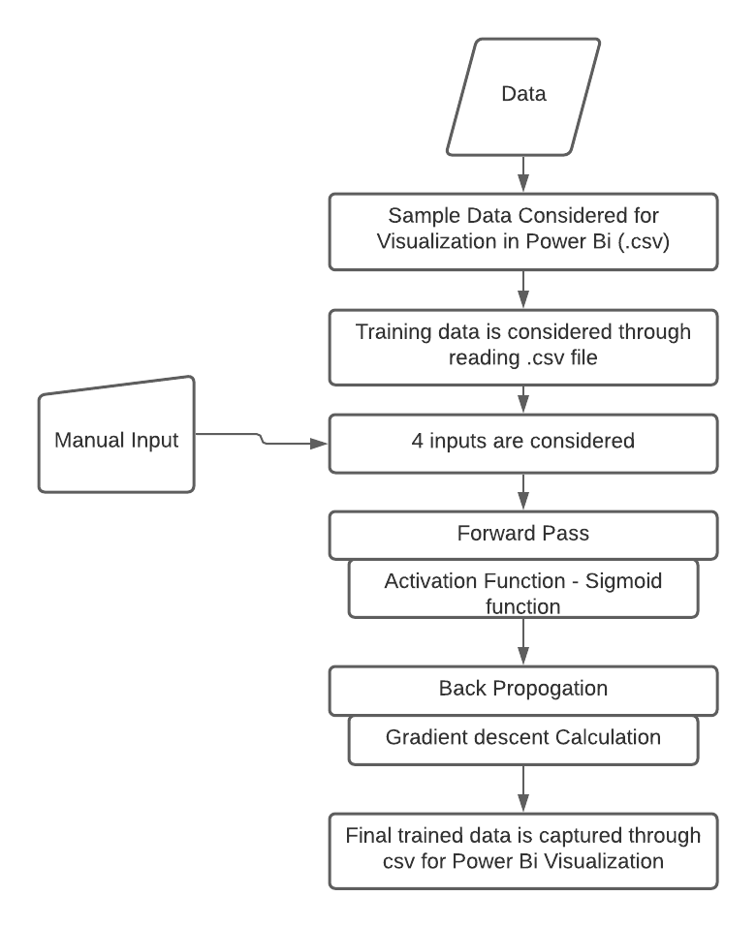
ANN Flow Chart

Slide 4
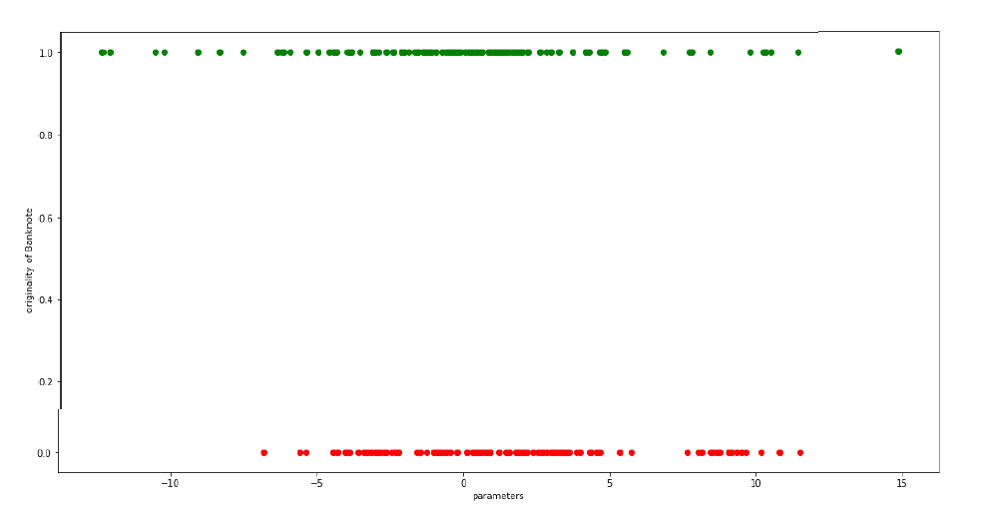
Visualization - Representation of Data
Represents Original banknote(1)
Represents Fake Banknotes(0)

Slide 5
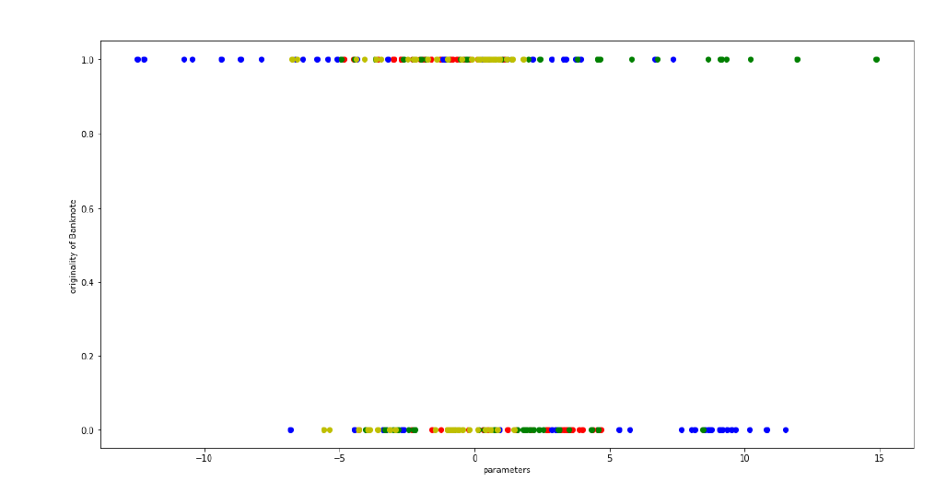
Parameters considered to check for the original/fake bank note,
The following graph shows the individual parameter, impacts on original/fake bank note
Parameter 1
Parameter 2
Parameter 3
Parameter 4

Slide 6
Working Output
--- output ---
# python3 main-4i-1h-1o.py
Stage 1) Random starting weights:
# Layer 1 (4 neurons, each with 4 inputs):
[[4.17022005e-01 7.20324493e-01 1.14374817e-04 3.02332573e-01]
[1.46755891e-01 9.23385948e-02 1.86260211e-01 3.45560727e-01]
[3.96767474e-01 5.38816734e-01 4.19194514e-01 6.85219500e-01]
[2.04452250e-01 8.78117436e-01 2.73875932e-02 6.70467510e-01]]
# Layer 2 (1 neuron, with 4 inputs):
[[0.4173048 ]
[0.55868983]
[0.14038694]
[0.19810149]]
Stage 2) New weights after training:
# Layer 1 (4 neurons, each with 4 inputs):
[[-0.80882082 0.44127317 -1.95958137 2.30771812]
[ 0.20107878 -0.26749924 0.34160953 -0.19752144]
[ 0.17624295 0.71150346 -0.08378137 0.32611257]
[ 0.29950621 0.95467863 0.59970368 -0.03013834]]
# Layer 2 (1 neuron, with 4 inputs):
[[ 1.07345495]
[-0.16503406]
[ 3.97252318]
[-4.81665941]]
Testing: Expectation O = [1]
Input: [-2.4941 3.5447 -1.3721 -2.8483]
Output: [0.99201085]
Testing: Expectation O = [0]
Input: [ 3.9362 10.1622 -3.8235 -4.0172]
Output: [0.00860221]

Slide 7
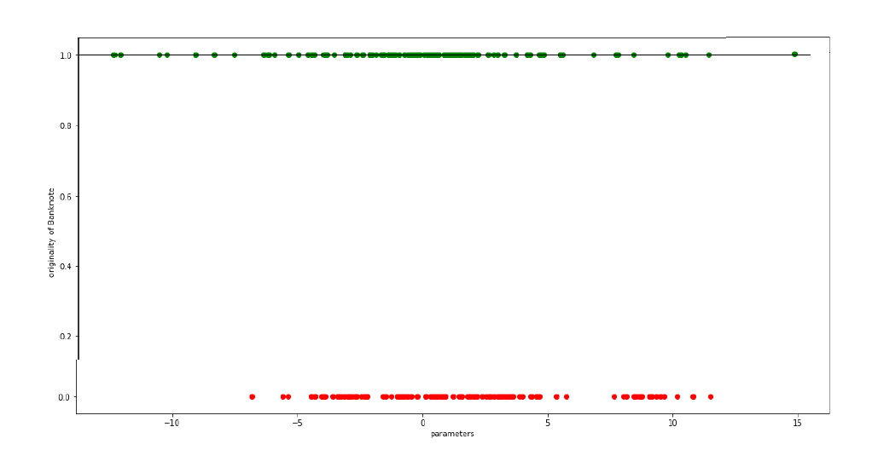
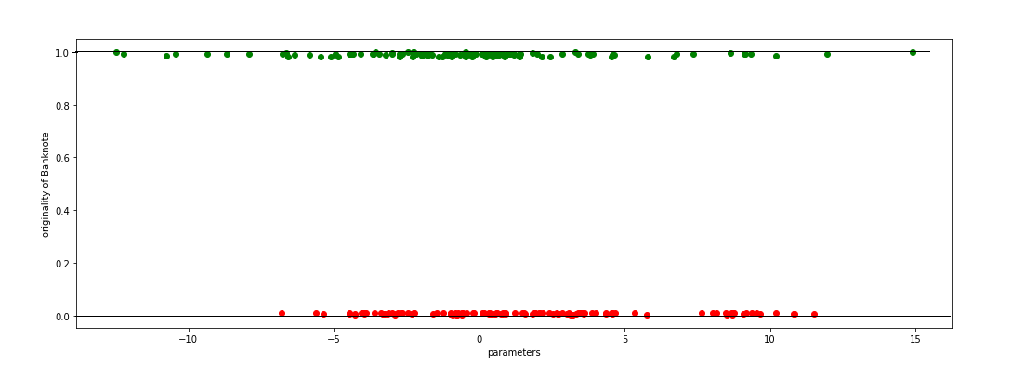
Figure 1: Dataset considered Considering line drawn at (1.0) as expected , We can see the trained data is almost as expected Figure 2: Output of trained data
Visualization Comparison with Input and Output

